Slide 1

MENTAL HEALTH
DASHBOARD

Slide 2
INSIGHTS
Social media is being used as a platform to express discussions about mental health, with most comments being neutral. The data also shows an increase in the number of comments related to mental health on social media compared to previous years, with an increase of 9.47%
Gender is an important factor to consider when addressing mental health. Mental illness rates are higher among females, younger adults, and individuals who identify as two or more races. Anxiety and depression are the most common types of mental illnesses, affecting approximately 1 in 5 U.S. adults. Young adults (ages 18-29) are more likely than older adults to report experiencing symptoms of anxiety or depression.
There is a high rate of comorbidity between mental health conditions and substance use disorders, with overlapping symptoms and shared risk factors contributing to the link. The graph shows that nearly 1 in 3 individuals with a mental health condition also have a substance use disorder, indicating the high prevalence of comorbidity between the two. About 50% of individuals with severe mental illnesses are affected by substance abuse.
Approximately 90% of people who die by suicide have a diagnosable mental health condition at the time of their death and suicide rates are highest among American Indian/Alaska Native. 4.4% of adults in the U.S. reported having suicidal thoughts in the past year.
60% of individuals with a mental illness not receiving treatment. Many individuals do not seek treatment for their mental health conditions due to stigma. Over 56% of adults with a mental illness did not receive treatment in the past year, with the most common reasons being the cost of care and a lack of access to providers.

Slide 3
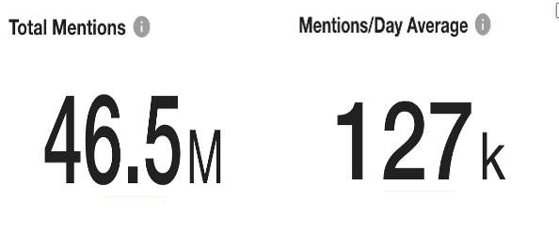
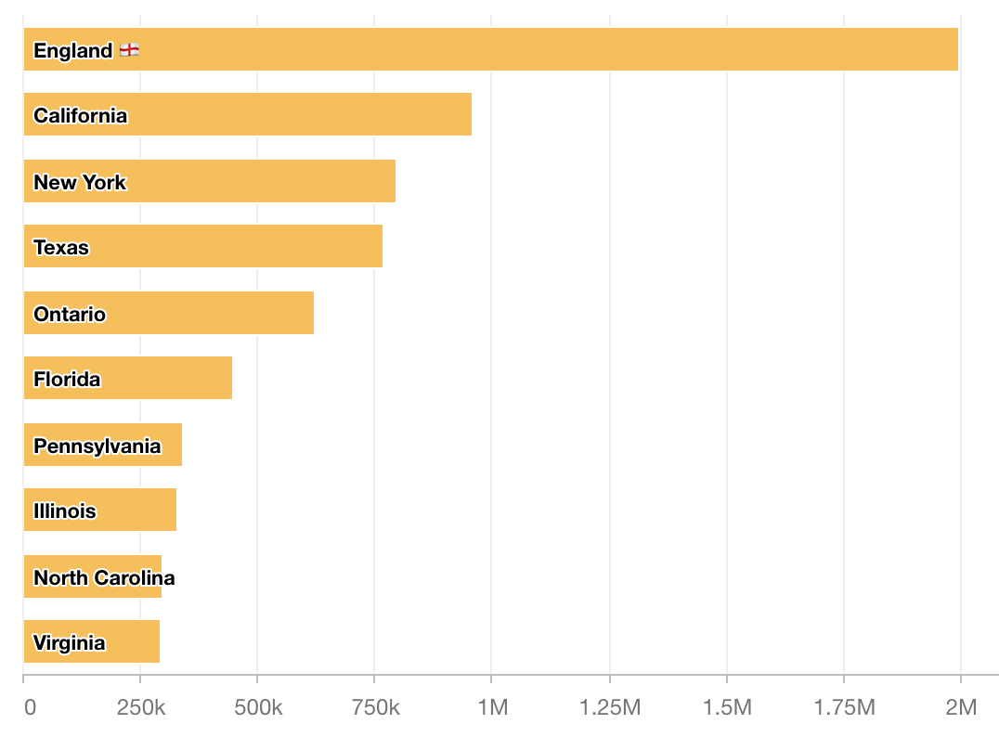
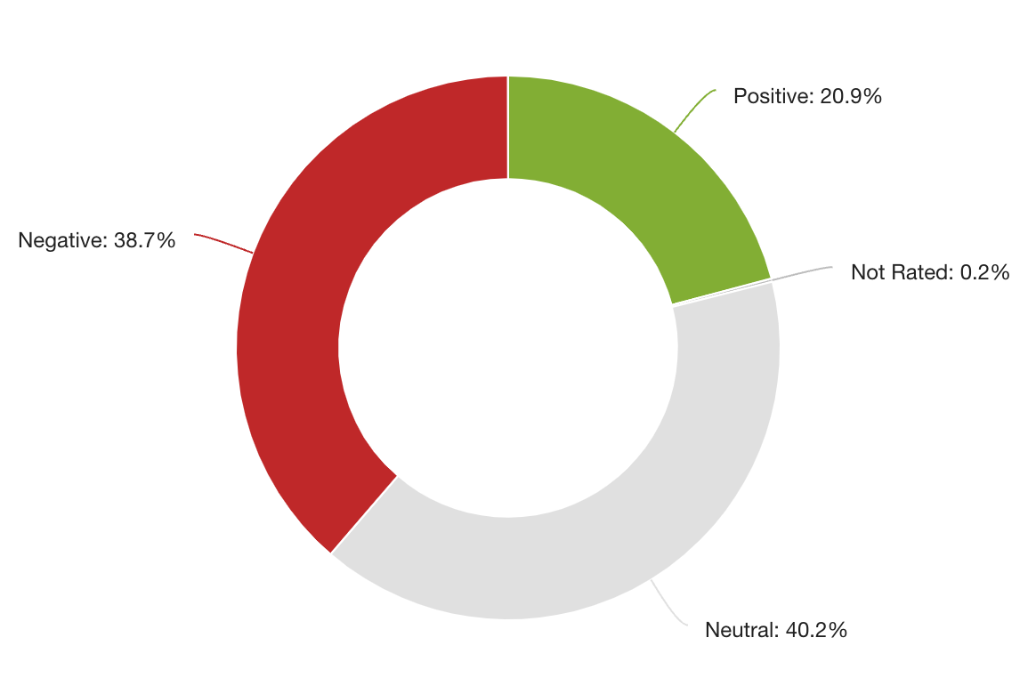
Social Media Impacts
Prevalence
Substance Use
Suicide
Treatment
Social media is being used as a platform to express discussions about mental health, with most comments being neutral. The data also shows an increase in the number of comments related to mental health on social media compared to previous years, with an increase of 9.47% in 2021 compared to 2020.
The sentiment towards mental health on social media is negative, with 38.7% of social media conversations having a negative sentiment.
Top States with highest social media presence on Mental Health
Sensitivity Of Comments on Social Media
This negative sentiment can sometimes potentially contribute to the stigmatization of mental health issues and discourage individuals from seeking help.
Notes:
Source : Meltwater - https://app.meltwater.com

Slide 4
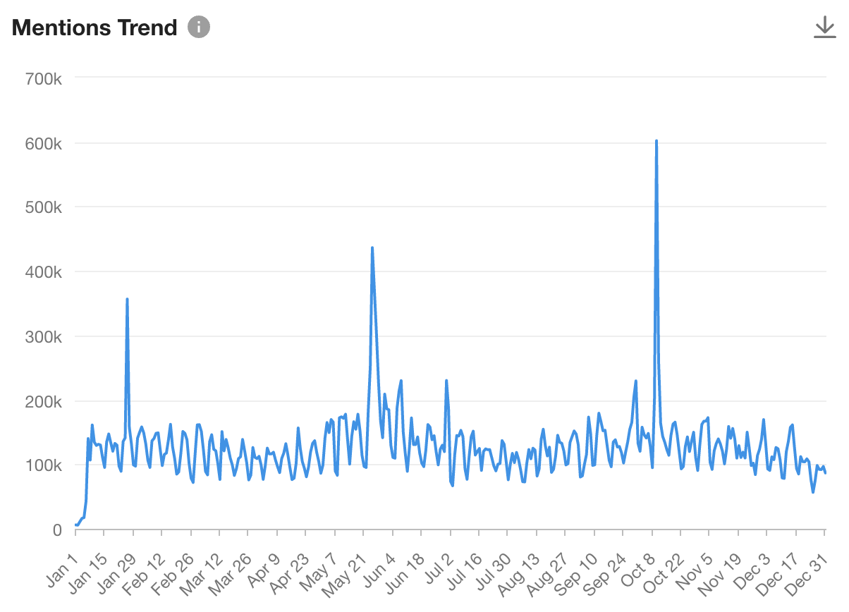
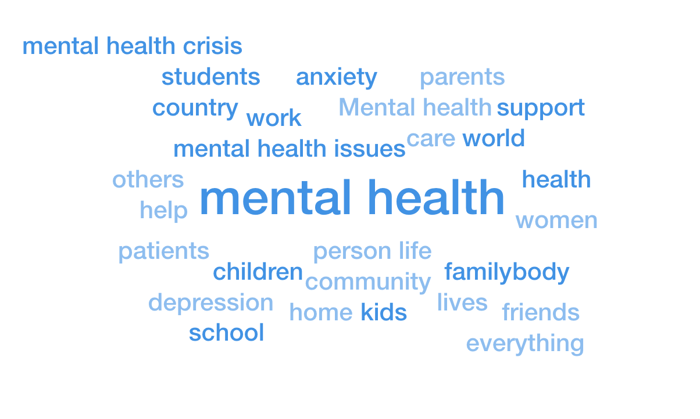
Social Media Impacts
Prevalence
Substance Use
Suicide
Treatment
On Twitter, the hashtag #mentalhealth has been used over 25 million times, with a peak in usage during Mental Health Awareness Week (May).
According to a study by the National Institute of Mental Health, social media users who frequently engage in mental health discussions are more likely to seek out and receive mental health services.
From 2018 to 2021, there was a 200% increase in the volume of social media conversations related to mental health.

Slide 5
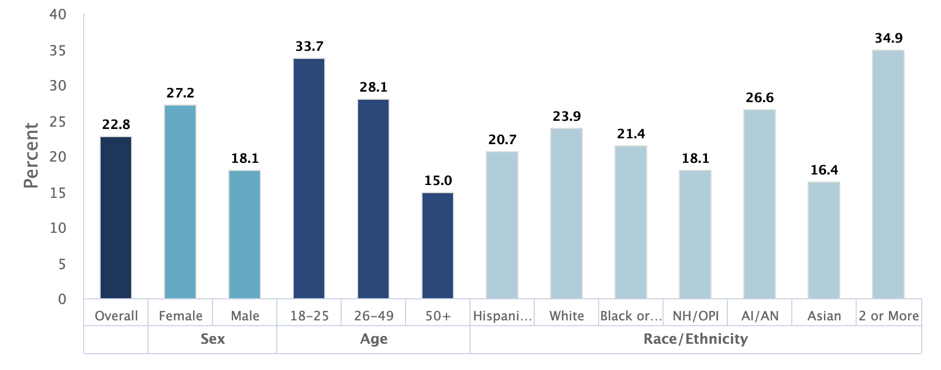
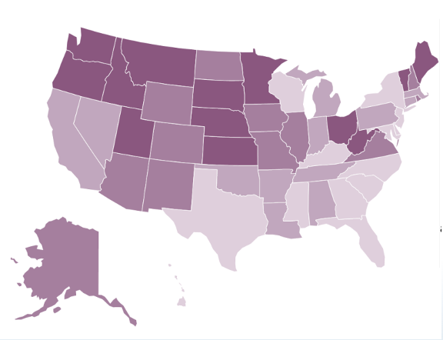
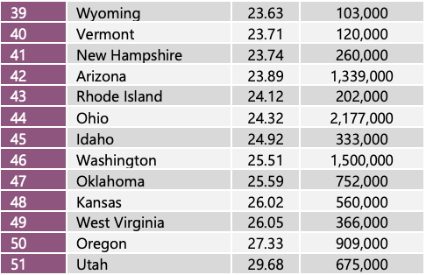
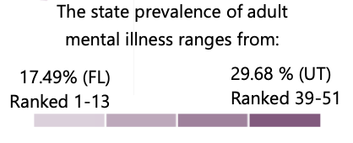
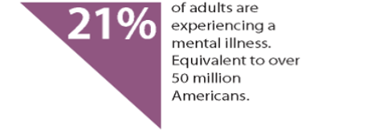
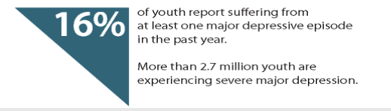
Social Media Impacts
Prevalence
Substance Use
Suicide
Treatment
Gender is an important factor to consider when addressing mental health. Mental illness rates are higher among females, younger adults, and individuals who identify as two or more races. Anxiety and depression are the most common types of mental illnesses, affecting approximately 1 in 5 U.S. adults.
Young adults (ages 18-29) are more likely than older adults to report experiencing symptoms of anxiety or depression.
Prevalence of Mental Health among the US
Prevalence of Mental Healthiness among the states
States with highest
Mental Health
Notes:
Source – National Institute of Mental Health - https://www.nimh.nih.gov

Slide 6
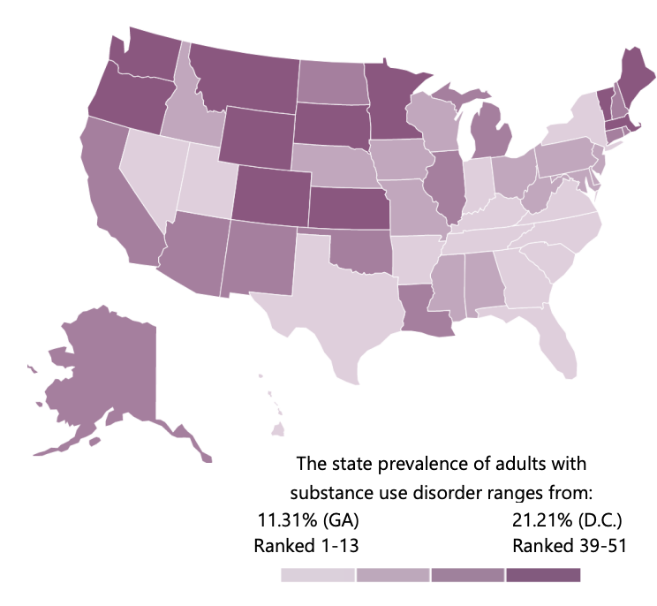
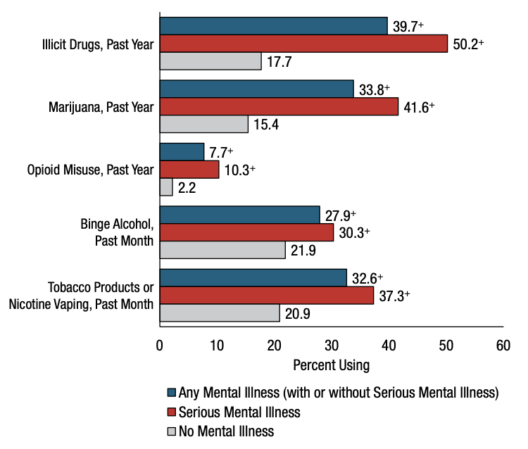
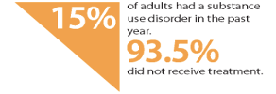
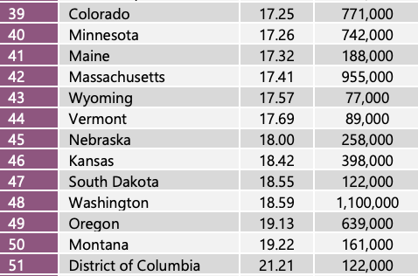
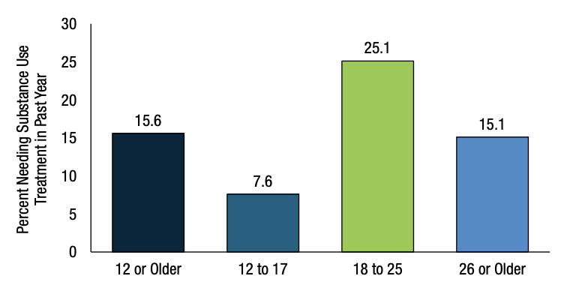
Social Media Impacts
Prevalence
Substance Use
Suicide
Treatment
There is a high rate of comorbidity between mental health conditions and substance use disorders, with overlapping symptoms and shared risk factors contributing to the link. Nearly 1 in 3 individuals with a mental health condition also have a substance use disorder, indicating the high prevalence of comorbidity between the two. about 50% of individuals with severe mental illnesses are affected by substance abuse.
Substance Use: Among Adults Aged 18 or Older; by Mental Illness Status
Type of Substance Used
Need of Substance use in Treatment
Notes:
Source: Substance Abuse and Mental Health Services Administration - https://www.samhsa.gov

Slide 7
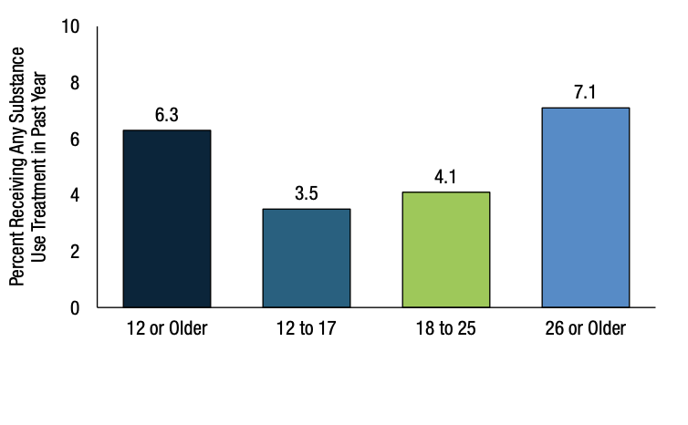
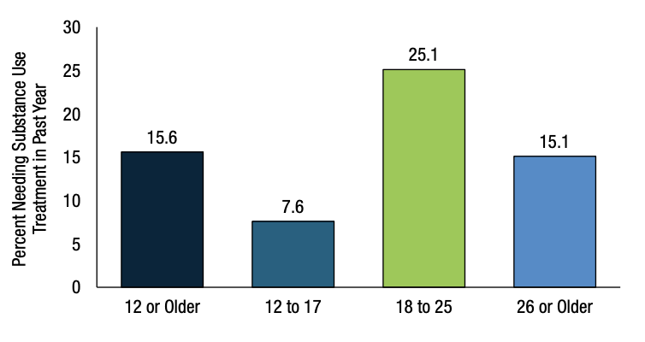
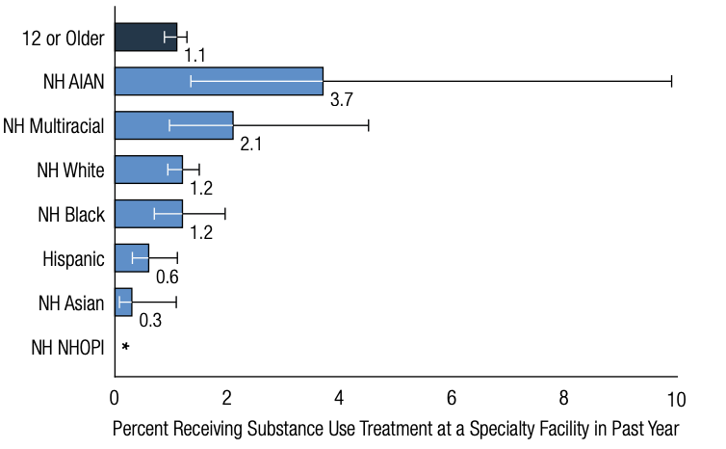
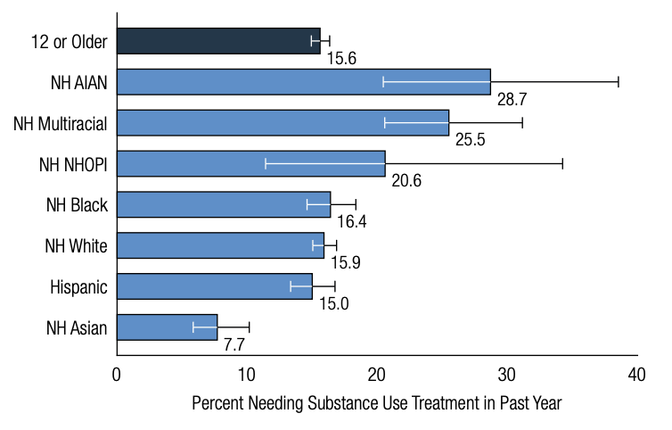
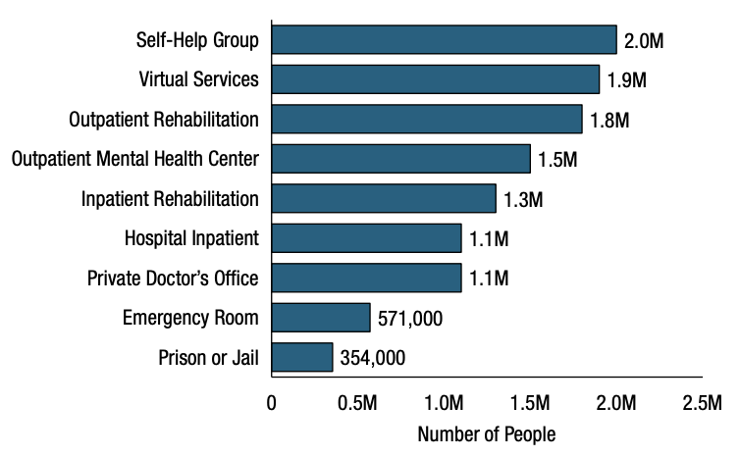
Social Media Impacts
Prevalence
Substance Use
Suicide
Treatment
Receiving Substance for Treatment
Access to substance use treatment for those with mental health disorders is often limited, leading to a need for integrated treatment programs.
Needing Substance for Treatment
Based on Age
Based on Age
Approximately 9.5 million adults in the United States received any substance use treatment in the past year. Of those, about 1.6 million received treatment for both a substance use disorder and a mental health condition.
Based on Ethnicity
Based on Ethnicity
Category of substance use treatment

Slide 8
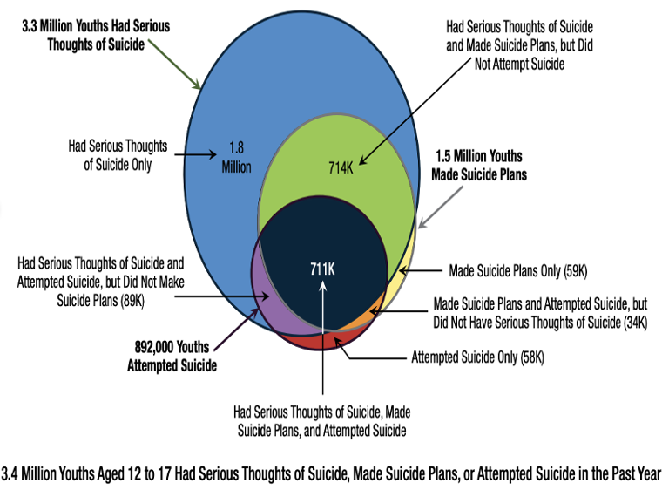
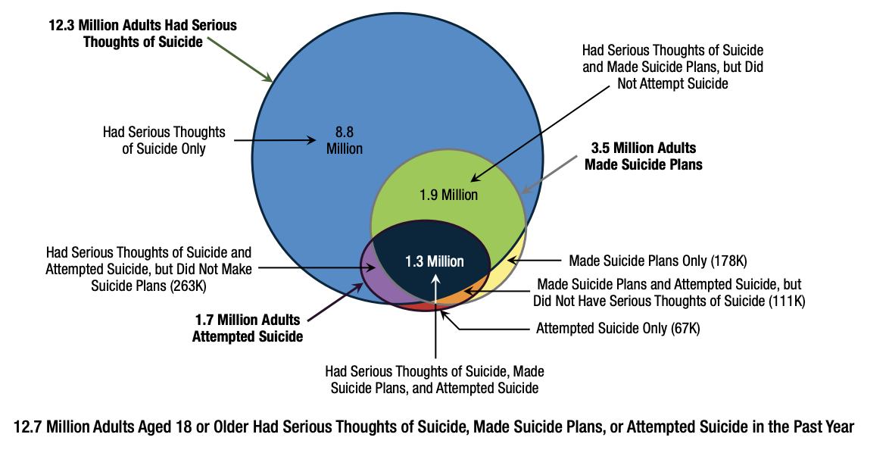
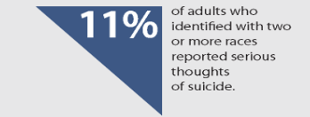
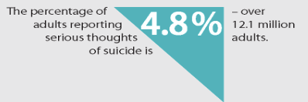
Social Media Impacts
Prevalence
Substance
Suicide
Treatment
Approximately 90% of people who die by suicide have a diagnosable mental health condition at the time of their death and suicide rates are highest among American Indian/Alaska Native.
Suicide Attempted by Youth
Suicide Attempted by Adult
Notes:
Source – Mental Health America - https://www.mhanational.org/

Slide 9
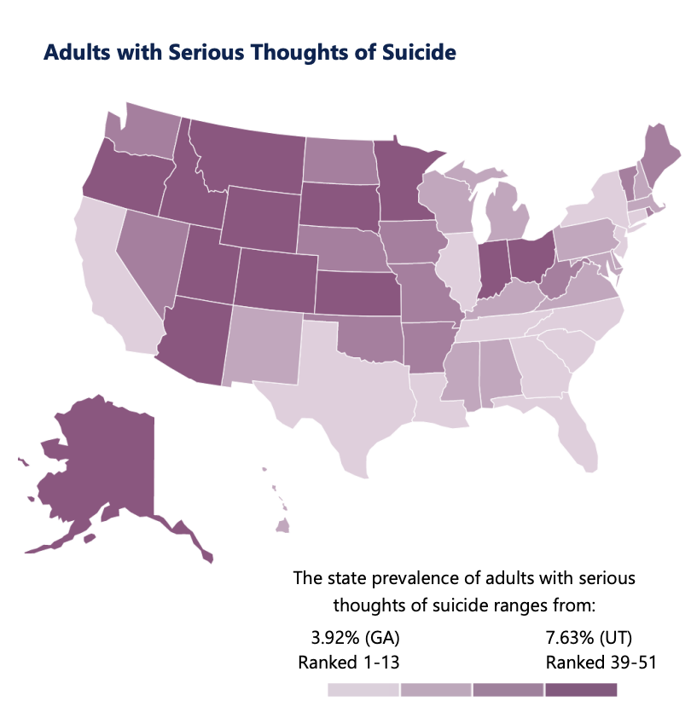
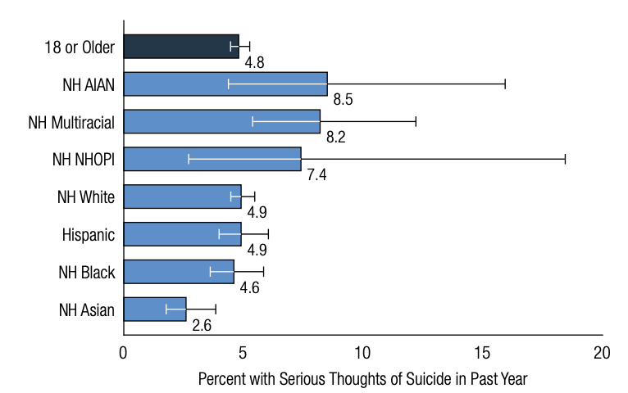
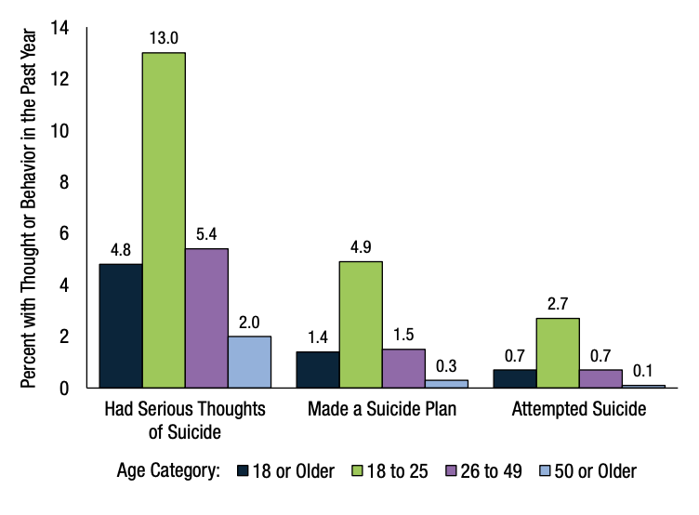
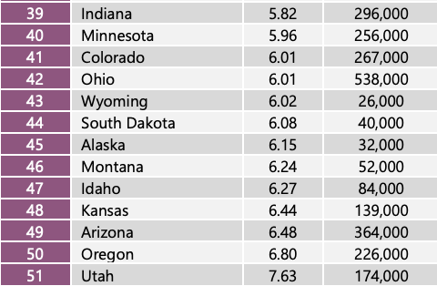
Social Media Impacts
Prevalence
Substance Use
Suicide
Treatment
Based on Ethnicity
Based on Age

Slide 10
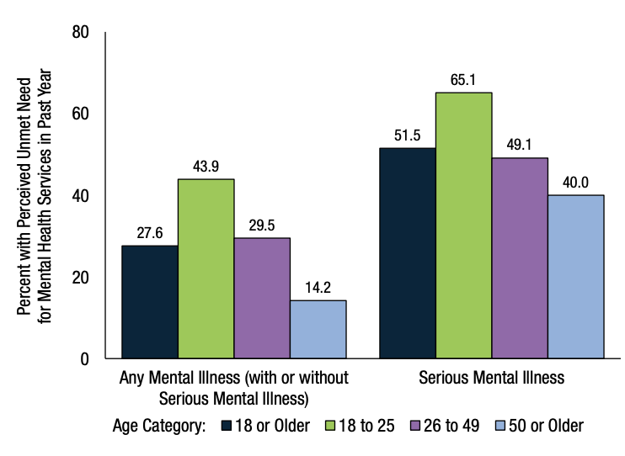
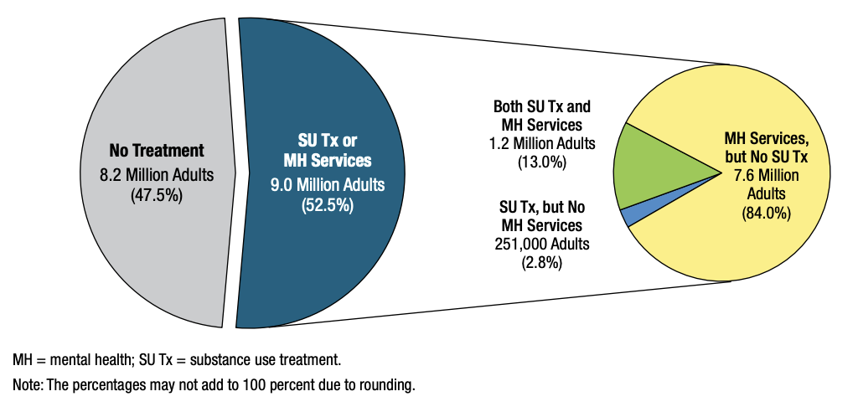
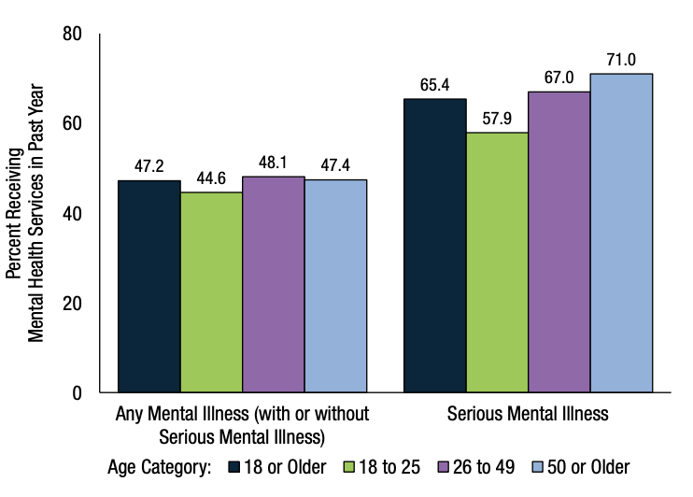
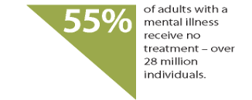
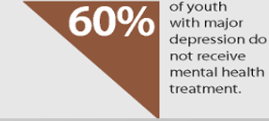
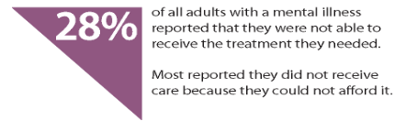
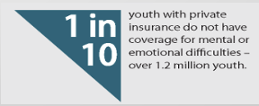
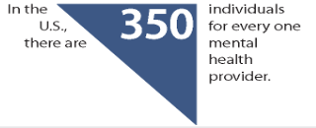
Social Media Impacts
Prevalence
Substance Use
Suicide
Treatment
60% of individuals with a mental illness not receiving treatment. Many individuals do not seek treatment for their mental health conditions due to stigma. Over 56% of adults with a mental illness did not receive treatment in the past year, with the most common reasons being the cost of care and a lack of access to providers.
No Treatment
Received Treatment
One of the main reason for not getting a treatment is because of no insurance (11%)
Notes:
Source - Centre for Disease Control and Source and prevention

